Slide 1


NFL Fantasy FB Predictions Final Project
Joseph Rafferty
Chrison Mills
Nicole Nanton
Kahsay Ftwi
Karl Parvez
Chandler Parrott

Slide 2

Why We Chose Fantasy Football….
Football provides many different variables and scenarios throughout the game that lead to various outcomes (wins, losses, individual player and unit production). To date, football has proven to be far less predictable than other, less complex sports such as baseball, basketball.
Over the past decade, Fantasy Football has grown from a fringe hobby to a multi-billion dollar industry and a primary driver of interest and revenue for the NFL.
Additionally, members of our group participate in fantasy football in their leisure time, so the results of this project could “potentially” be valuable in the future to identify trends for personal use.

Slide 3

Our (Long) ETL/Machine Learning Process
We found our data on airyards.com, a website which provided mostly clean data in the form of csv files. We imported those files into our jupyter notebooks to analyze. Our machine learning predictions were based off of the prior year statistics, which were not included in.
During this process, we cleaned our data to eliminate null or empty values, as well as two infinite values. We then ran multiple machine learning models to determine which gave us the most accurate predictions based off of our data.
For our machine learning process, we tested 9 models in total and compared results. The testing accuracy for these models were all very close, but none were proved particularly powerful (R-Squared values ranging from .36-.40). We chose the Random Forest model to analyze because we believe the feature importance metrics will prove more useful and interesting than the ML predictions.

Slide 4


Model #1: Random Forest on all Features
22 Features
If correlation is evenly distributed amongst all features, each would account for ~4.5% of the total correlation. Any feature reporting higher than 4.5% may be worth exploring more.
Take Aways:
These are the metrics that your average beginner fantasy football player would likely look at when drafting a team. We are looking to find better measures that better measure success year over year.
-Prior Year Yards (PY_Yds): 0.12397523785361723
-Prior Year Touchdowns (PY_TD): 0.01929117318289102
-Prior Year Receptions: (PY_Rec): 0.043006157076306624
-Prior Year Points Per Receptions (PY_PPR_Points): 0.107171677573783

Slide 5


…Continuation on Model #1
*These efficiency metrics all fall below the 4.5% threshold. This is interesting because we generally associate efficiency with skill/talent and higher skill/talent with more production over the long term.
-Prior Year Yards Per Target (PY_Yds/TGT): 0.040146512893303836
-Prior Year Yards After Catch Per Target (PY_YAC/TGT): 0.0349415227804
-Prior Year Yards After Catch Per Reception (PY_YAC/Rec): 0.03428098799156202
-Prior Year Receiver Air Conversion Ratio (PY_RACR): 0.019784000253251322
-Prior Year Catch Rate (PY_Catch_Rate): 0.032880793545673685
-Prior Year Yards Per Receiver (PY_YPR): 0.03215725483476958

Slide 6
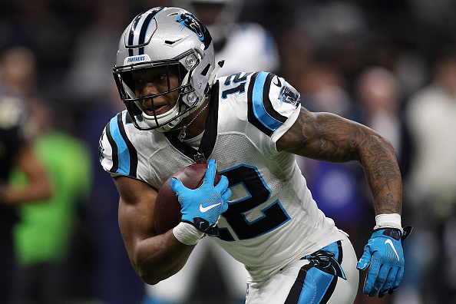

.....Continuation of Model #1
Below are opportunity metrics. Most are well below the 4.5% threshold. This is initially surprising, because opportunity is necessary for production (a popular fantasy football axiom states it simply: ‘Opportunity is king’), but a closer look at the metrics in question, and it starts to make more sense. The total volume statistics like Targets and Air Yards are not far off the threshold, but the per target & per reception numbers, in particular, are volume agnostic and therefore not a good measure of opportunity.
-Prior Year Targets (PY_Tgt): 0.04392263336751056
-Prior Year Receptions (PY_Rec): 0.043006157076306624
-Prior Year Air Yards (PY_AY): 0.03895073957620146
-Prior Year Market Share Air Yards (PY_MS_AY): 0.03192314195
-Prior Year Unrealized Air Yards (PY_UAY): 0.015689200597976193
-Prior Year Unrealized Air Yards Per Target (PY_UAY/Tgt): 0.0212372749116950
-Prior Year Air Yards Per Reception (PY_AY/Rec): 0.017944113919136973
-Prior Year Unrealized Air Yards Per Reception (PY_UAY/Rec): 0.015689200597
-Prior Year Air Yards Per Target (PY_AY/Tgt): 0.011067612593930824
-Prior Year Average Year Depth Of Target (PY_aDOT): 0.01072167314894976

Slide 7

Lastly….
The final opportunity metric, WOPR (Wide Receiver Opportunity Rating), on the other hand, is extremely interesting. At more than 3x the 4.5% threshold. WOPR easily stands out from the crowd of other metrics. This is because WOPR is a weighted opportunity metric that incorporates the WRs market share of both air yards and targets. This is a much better measure of opportunity than either air yards or targets separately. The reason for this is that, while volume of targets is important, each target is not created equally – a target deeper down the field is more valuable that a target closer to the line of scrimmage.
Prior Year Wide Receiver Opportunity Rating (PY_WOPR): 0.17266672813526432
*Other metrics that beat the 4.5% threshold, but neither beat the prior year yards or PPR points.
Prior Year Target Share (PY_TGT_Share): 0.07258852087143962
Prior Year Yards After Catch (PY_YAC): 0.0512092099785414

Slide 8


What About the Predictions…?
As was shown by the relatively low R-Squared values, the predictions produced by our machine learning model on the testing data were not very accurate. Further, we ran into an issue we were not able to resolve in the allotted time: the range of the predictions was fundamentally wrong. However, we did notice that the predictions did lend themselves to reasonable (if occasionally surprising) rankings. We therefore converted the PPR Point predictions to rankings, which and have chosen to present our findings as top 50 rankings for the 2020 season.

Slide 9
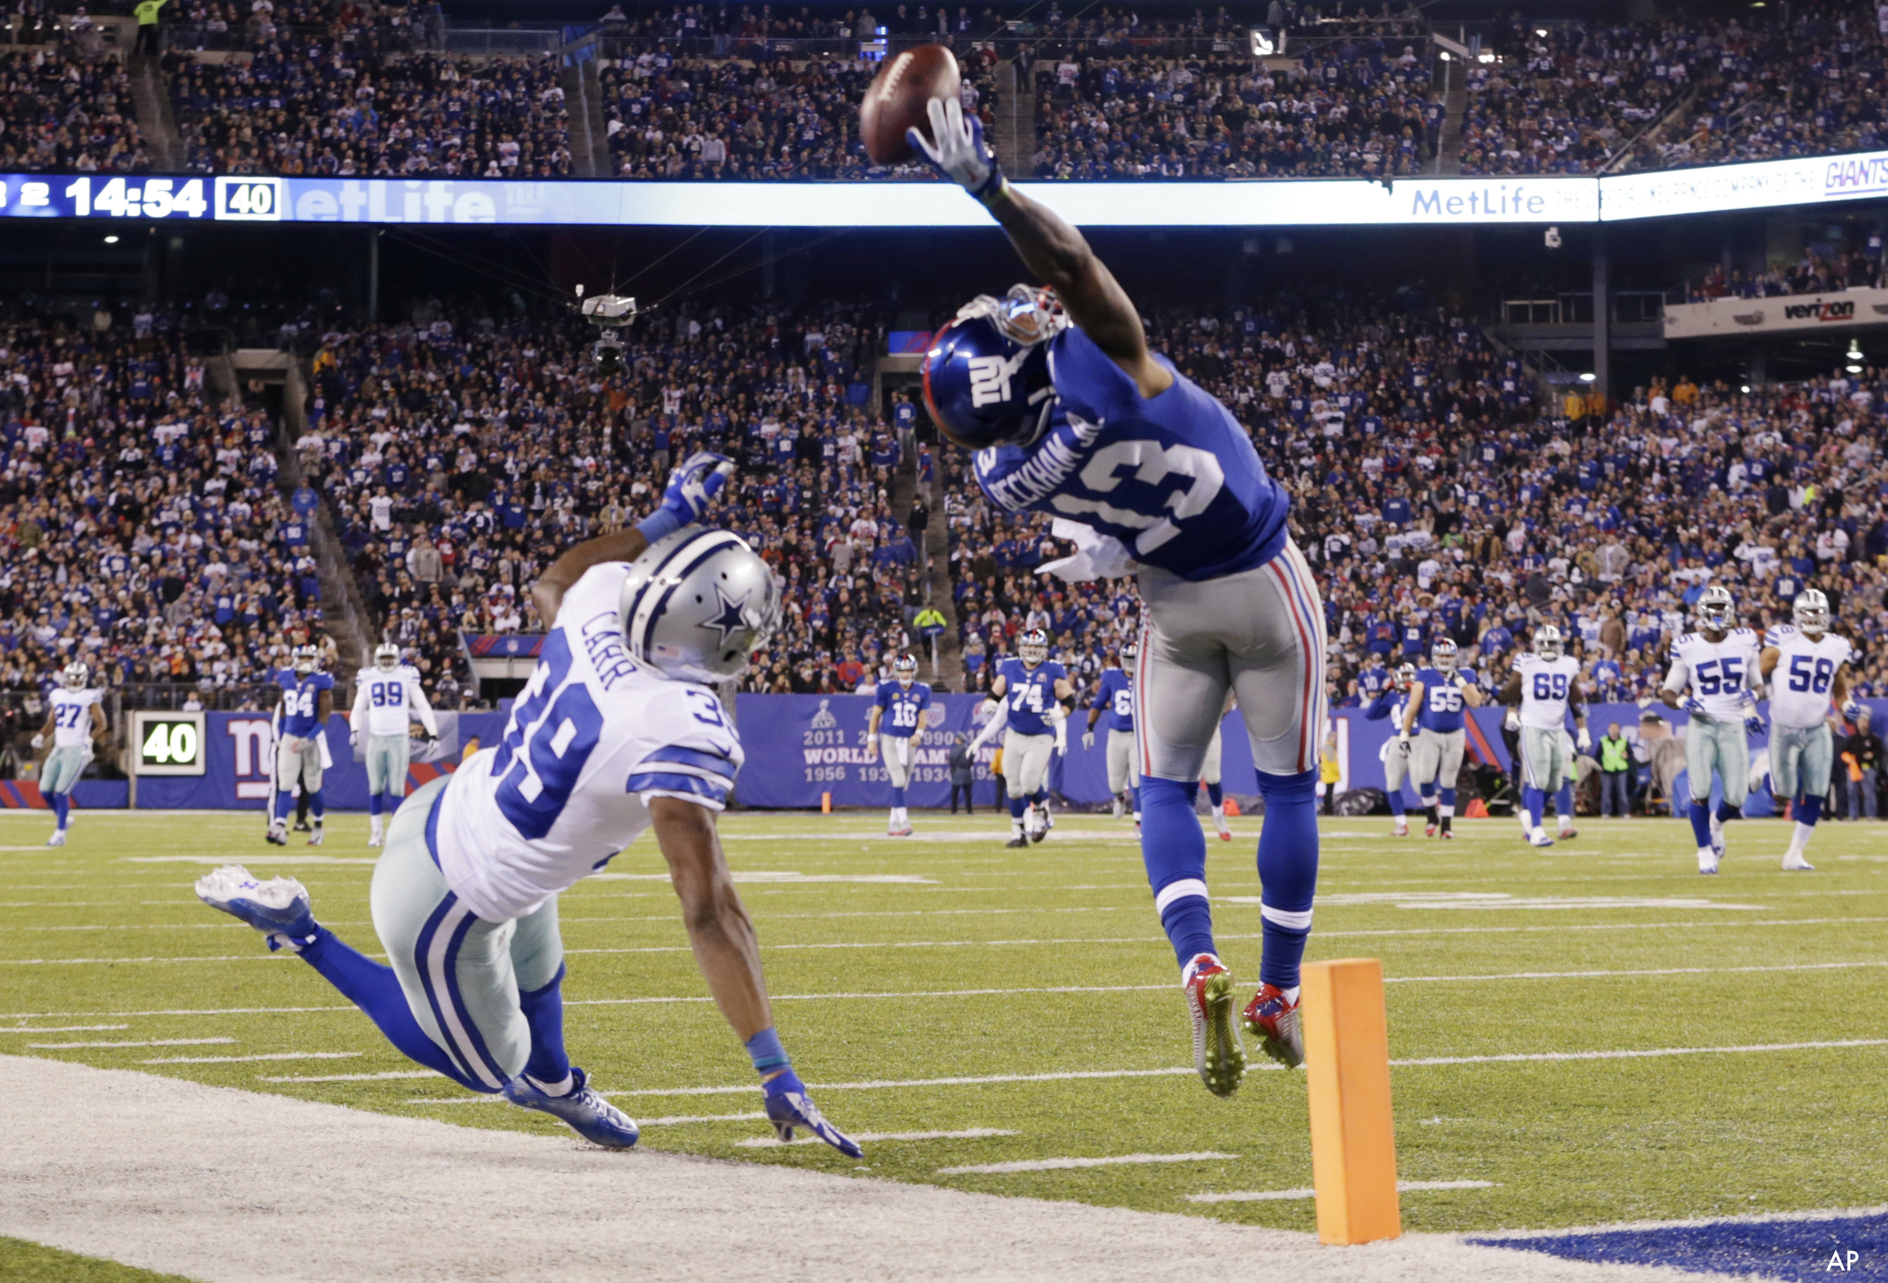

Our conclusions and some takeaways…
Not a great topic for making predictions for machine learning due to the amount of variables.
We found a few stats that lead our predictions: weighted opportunity rating, prior year yards and points per perception.
Efficiency does not have the impact in year after year outcome we thought it would.
Opportunity contributes the most to predictions.
In the future, we would like to explore what drives opportunity to predict possible outcomes.

Slide 10

Thank you!

